Slide 1
Skype IM Pretty Printer
Excelsior Hack Day I Project by Dmitry Leskov

Slide 2


The Problem
→

Slide 3
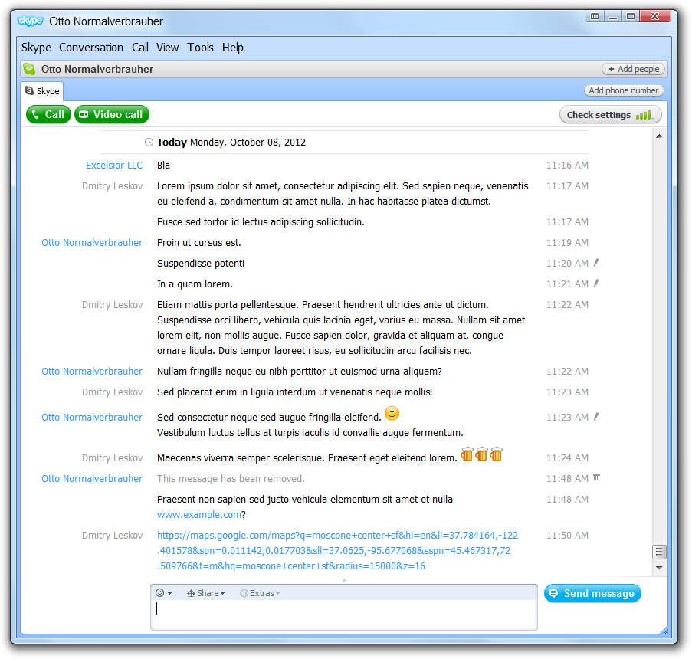
Nicely formatted chat…
Clearly seen participant names
Non-obtrusive timestamps
Visually separated messages
Clickable URLs
Emoticons

Slide 4
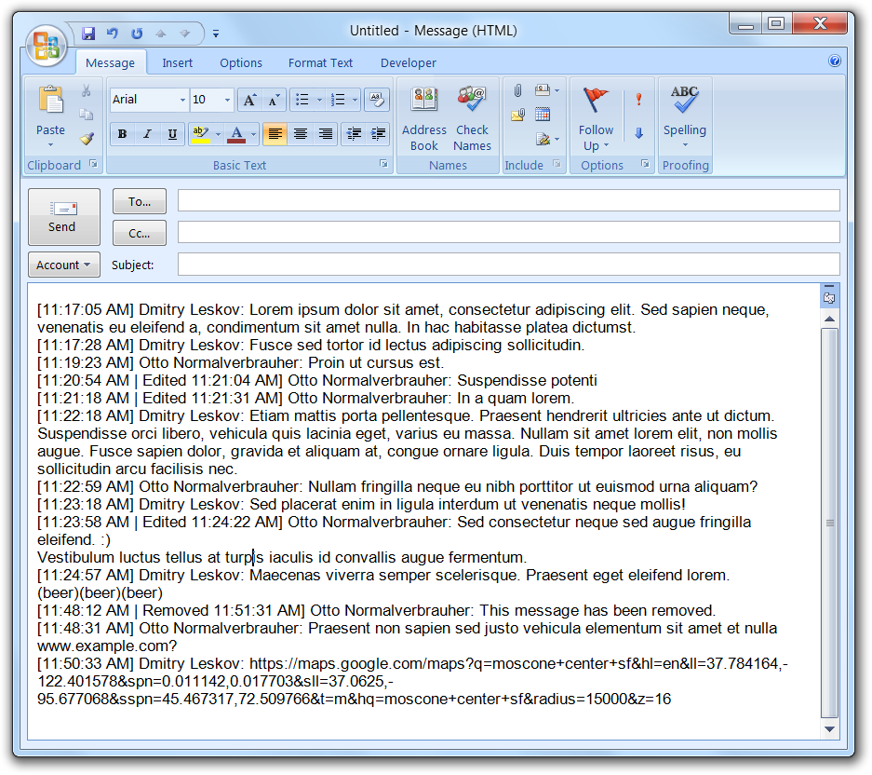
…becomes character soup
One block of text
No date for fresh messages
Yet timestamps clutter the view
Hard to identify author
Unrecognized URLs/emoticons

Slide 5
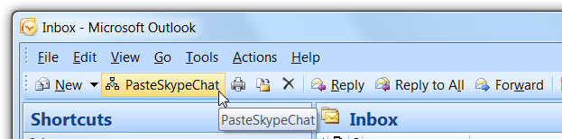
Solution
Outlook VBA to the rescue!
(What else would you have expected from a Director of Marketing, anyway?)
Just 200 lines of code and I have a button that…

Slide 6
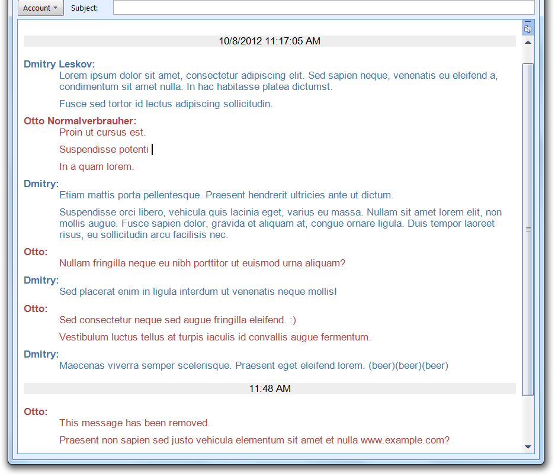
Pastes a nicely formatted chat!
Full date at top, timestamps after long breaks
Names typeset in bold, shortened on repeat
Space between messages

Slide 7
Todo
Handle corner cases (e.g. same first names)
Recognize links
Recognize emoticons
Configuration parameters
Formatting templates
Documentation
Web page (@50%)

